Slide 1
Module 5 - SQL Data Definition Language (DDl)
Creating Tables, Keys, and Constraints

Slide 2
Recap & Transition
Last week we normalized schemas (up to BCNF).
Now we turn designs into implementation.

Slide 3
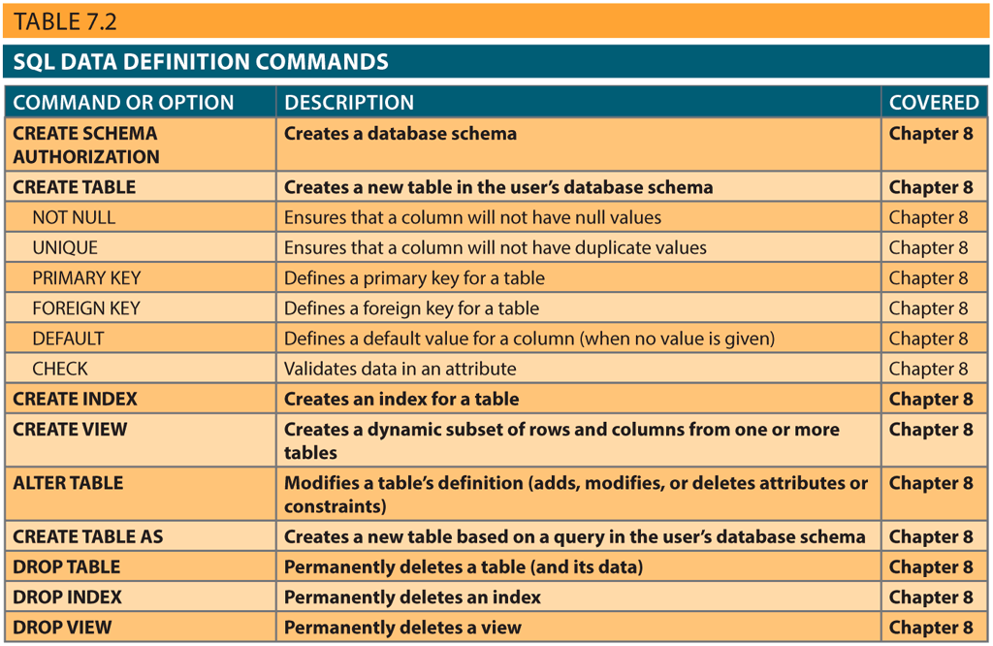
SQL Language Families
DDL: Data Definition Language
Create & alter schemas
DML: Data Manipulation Language
Manipulate date (insert/update/delete)
DCL: Data Control Language
Permissions & access
TCL: Transaction Control Language
Transactions

Slide 4
Data Definition Commands (DDL)
Create a database
Determine attribute data types
Create tables
Alter table structures
Delete tables

Slide 5

Creating a Database

Slide 6
Creating Tables

Slide 7
SQL Syntax
CAPITALS Required SQL command keywords
Italics A parameter provided by the end user (generally required)
{a | b | ..} A mandatory parameter; use one option from the list
[......] An optional parameter--anything inside is optional
Tablename / Column
data type A valid data-type definition
constraint A valid constraint definition
condition A valid conditional expression (evaluate to true or false)
columnlist One or more column names or expressions separated by commas
tablelist One or more table names separated by commas
conditionlist One or more conditional expressions separated by logical operators
expression A simple value or a formula
It is important to learn how to read and understand the syntax!

Slide 8
Creating Tables
CREATE TABLE tablename (
Column1 data type [constraint] [,
Column2 data type [constraint]] [,
PRIMARY KEY(column1 [, column2]) ] [,
FOREIGN KEY(column1 [, column2]) REFERENCES tablename][,
CONSTRAINT constraint] );

Slide 9

Creating Tables
CREATE TABLE tablename (
Column1 data type [constraint] [,
Column2 data type [constraint]] [,
PRIMARY KEY(column1 [, column2]) ] [,
FOREIGN KEY(column1 [, column2]) REFERENCES tablename][,
CONSTRAINT constraint] );
What is the shortest possible CREATE TABLE query?!

Slide 10
SQL Data Types

Slide 11
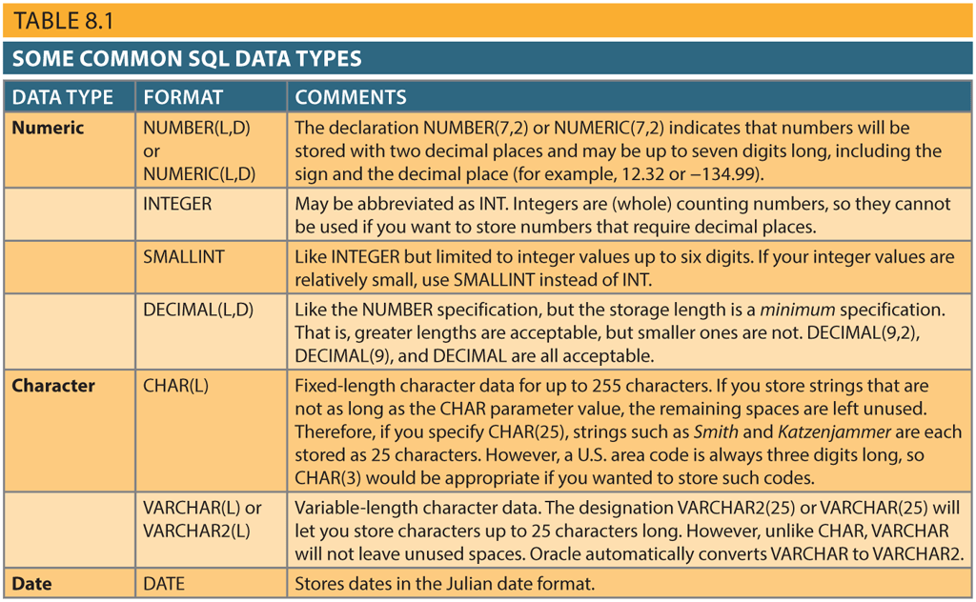
SQL Data Types
Common types:
Character
Fixed length or variable Length
CHAR / VARCHAR
Numeric
Different numeric types based on length and whether values can contain decimal digits
NUMERIC, INTEGER
Date
Date arithmetics
DATE
Boolean
BOOLEAN
Best practice: choose by meaning (e.g., area code = CHAR).

Slide 12
Determining Attribute Data Types
We must consider the expected use of the attribute to properly define attribute types.
Sometimes you need professional judgment to determine a data type.

Slide 13
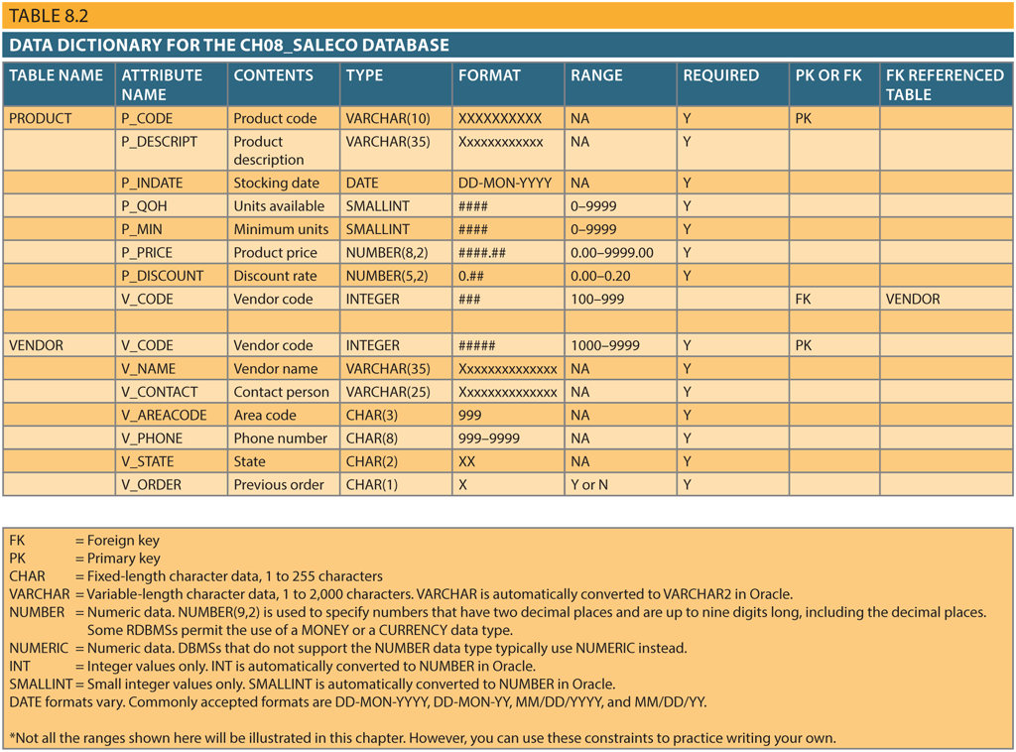
Example
V_AREACODE is saved as a character (CHAR(3)) even though it only contains digits - why?
Adding / subtracting area codes does not make sense!
An area/zip code might start with a zero. If saved as a number, the leading zero might get dropped.

Slide 14
Example
If you save the number of bathrooms (H_BATH_NUM) as CHAR(3) -- you might think that the application should not do arithmetics (+, -, /, *) with the number -- then:
A query to sort the homes by number of bathrooms would put '10' before '2'!
Here's where you need to use your professional judgment to decide whether H_BATH_NUM should be stored as character or numeric.

Slide 15
SQL Constraints
PRIMARY KEY
FOREIGN KEY
Actions: ON DELETE / ON UPDATE → CASCADE / SET NULL / SET DEFAULT
NOT NULL
UNIQUE
DEFAULT
CHECK
To validate the value entered for an attribute

Slide 16
Vendor Table
CREATE TABLE VENDOR (
V_CODE INTEGER NOT NULL UNIQUE,
V_NAME VARCHAR(35) NOT NULL,
V_CONTACT VARCHAR(25) NOT NULL,
V_AREACODE CHAR(3) NOT NULL,
V_PHONE CHAR(8) NOT NULL,
V_STATE CHAR(2) NOT NULL,
V_ORDER CHAR(1) NOT NULL,
PRIMARY KEY(V_CODE));

Slide 17
Vendor Table
data type
CREATE TABLE VENDOR (
V_CODE INTEGER NOT NULL UNIQUE,
V_NAME VARCHAR(35) NOT NULL,
V_CONTACT VARCHAR(25) NOT NULL,
V_AREACODE CHAR(3) NOT NULL,
V_PHONE CHAR(8) NOT NULL,
V_STATE CHAR(2) NOT NULL,
V_ORDER CHAR(1) NOT NULL,
PRIMARY KEY(V_CODE));
constraint
Spaces are used to line up pieces of a query

Slide 18
Product Table
CREATE TABLE PRODUCT (
P_CODE VARCHAR(10) NOT NULL UNIQUE,
P_DESCRIPT VARCHAR(35) NOT NULL,
P_INDATE DATE NOT NULL,
P_QOH SMALLINT NOT NULL,
P_MIN SMALLINT NOT NULL,
P_PRICE NUMERIC(8,2) NOT NULL,
P_DISCOUNT NUMERIC(5,2) NOT NULL,
V_CODE INTEGER
PRIMARY KEY(P_CODE),
FOREIGN KEY(V_CODE) REFERENCES VENDOR ON UPDATE CASCADE );

Slide 19
Product Table
CREATE TABLE PRODUCT (
P_CODE VARCHAR(10) NOT NULL UNIQUE,
P_DESCRIPT VARCHAR(35) NOT NULL,
P_INDATE DATE NOT NULL,
P_QOH SMALLINT NOT NULL,
P_MIN SMALLINT NOT NULL,
P_PRICE NUMERIC(8,2) NOT NULL,
P_DISCOUNT NUMERIC(5,2) NOT NULL
V_CODE INTEGER
PRIMARY KEY(P_CODE),
FOREIGN KEY(V_CODE) REFERENCES VENDOR ON UPDATE CASCADE );
Ensures entity integrity
Creates a unique index on P_CODE
Use UNIQUE to avoid duplicate values in a column
Ensures referential integrity
If VENDOR's V_CODE is changed, all FKs referencing the V_CODE are updated.
Notes:
Default FOREIGN KEY ACTION is NO ACTION

Slide 20
Customer Table
CREATE TABLE CUSTOMER (
CUS_CODE NUMERIC PRIMARY KEY,
CUS_LNAME VARCHAR(15) NOT NULL,
CUS_FNAME VARCHAR(15) NOT NULL,
CUS_INITIAL CHAR(1),
CUS_AREACODE CHAR(3) DEFAULT '615' NOT NULL
CHECK(CUS_AREACODE IN ('615', '713', '931')),
CUS_PHONE CHAR(8) NOT NULL,
CUS_BALANCE NUMERIC(9, 2) DEFAULT 0.00,
CONSTRAINT CUS_UI1 UNIQUE(CUS_LNAME, CUS_FNAME));

Slide 21
Customer Table
CREATE TABLE CUSTOMER (
CUS_CODE NUMERIC PRIMARY KEY,
CUS_LNAME VARCHAR(15) NOT NULL,
CUS_FNAME VARCHAR(15) NOT NULL,
CUS_INITIAL CHAR(1),
CUS_AREACODE CHAR(3) DEFAULT '615' NOT NULL
CHECK(CUS_AREACODE IN ('615', '713', '931')),
CUS_PHONE CHAR(8) NOT NULL,
CUS_BALANCE NUMERIC(9, 2) DEFAULT 0.00,
CONSTRAINT CUS_UI1 UNIQUE(CUS_LNAME, CUS_FNAME));
Constraints can be defined in two places:
In column definition (column constraint) → applies to one column
Using CONSTRAINT keyword (table constraint) → may apply to multiple columns
Awayse name your constraints
CHECK only validates values for attributes in this table. To validate attributes in other tables you should use triggers

Slide 22
Invoice Table
CREATE TABLE INVOICE (
INV_NUMBER NUMERIC PRIMARY KEY,
CUS_CODE NUMERIC NOT NULL REFERENCES CUSTOMER(CUS_CODE),
INV_DATE DATE DEFAULT SYSDATETIME() NOT NULL,
CONSTRAINT INV_CK1 CHECK(INV_DATE >'01-JAN-2018'));
Notes:
The default precision precision and scale varies based on the DBMS.
In SQL Server default precision is 18 and default scale is 0

Slide 23
Invoice Table
CREATE TABLE INVOICE (
INV_NUMBER NUMERIC PRIMARY KEY,
CUS_CODE NUMERIC NOT NULL REFERENCES CUSTOMER(CUS_CODE),
INV_DATE DATE DEFAULT SYSDATETIME() NOT NULL,
CONSTRAINT INV_CK1 CHECK(INV_DATE >'01-JAN-2018'));
You see that a FK constraint can also be defined in column definition. Remember:
Constraints can be defined in column definition or with CONSTRAINT keyword

Slide 24
Line Table
CREATE TABLE LINE (
INV_NUMBER NUMERIC NOT NULL,
LINE_NUMBER NUMERIC(2, 0) NOT NULL,
P_CODE VARCHAR(10) NOT NULL,
LINE_UNITS NUMERIC(9, 2) DEFAULT 0.00 NOT NULL ,
LINE_PRICE NUMERIC(9, 2) DEFAULT 0.00 NOT NULL ,
PRIMARY KEY(INV_NUMBER, LINE_NUMBER),
FOREIGN KEY(INV_NUMBER) REFERENCES INVOICE ON DELETE CASCADE,
FOREIGN KEY(P_CODE) REFERENCES PRODUCT(P_CODE),
CONSTRAINT LINE_UI1 UNIQUE(INV_NUMBER, P_CODE));

Slide 25
Line Table
CREATE TABLE LINE (
INV_NUMBER NUMERIC NOT NULL,
LINE_NUMBER NUMERIC(2, 0) NOT NULL,
P_CODE VARCHAR(10) NOT NULL,
LINE_UNITS NUMERIC(9, 2) DEFAULT 0.00 NOT NULL ,
LINE_PRICE NUMERIC(9, 2) DEFAULT 0.00 NOT NULL ,
PRIMARY KEY(INV_NUMBER, LINE_NUMBER),
FOREIGN KEY(INV_NUMBER) REFERENCES INVOICE ON DELETE CASCADE,
FOREIGN KEY(P_CODE) REFERENCES PRODUCT(P_CODE),
CONSTRAINT LINE_UI1 UNIQUE(INV_NUMBER, P_CODE));
Composite PK → should be defined as table constraint
Recommended for weak entities
To ensure the same product is not ordered twice in the same invoice

Slide 26
A Few Notes
RDMBS automatically enforces referential integrity
FKs cannot be invalid
Parent record cannot be deleted if referenced by a child
The order in which you create tables matters
VENDOR should be created before PRODUCT.
Alwayse create the 1 side of a 1:M relationship first. Why?

Slide 27
Altering Table Structures

Slide 28
Altering & Dropping Tables
You can use ALTER TABLE command to:
Add / Modify columns
Add constraints
Remove a column / constraint
Change a column data type or other characteristics
You can use DROP TABLE command to delete a table from the database

Slide 29
Checklist for Good Schema DDL
Primary Key defined.
Foreign Keys enforce relationships.
Data types match semantics.
Constraints enforce business rules.

Slide 30
Takeaways
DDL turns designs into actual databases.
Constraints protect integrity.
Sets up next week: DML (working with data).

